Slide 1
PREVAYL
Case Study

Slide 2
DOOH flexibility supports uplift in sales for Prevayl
The Brief
To launch Prevayl in Greater Manchester- the world’s most accurate wearable tech brand, fused with premium sportswear. A three-week campaign, targeting arterial routes into the city, focussing on ABC1 consumers.
The Campaign
Alight Media’s D48 presence throughout the city allowed for Prevayl to simultaneously target their key audience and form part of their one day Marathon activation. At short notice presence was increased to further support their social media output and regional TV presence.
11
2.17M
324k
Using 11 D48 panels
Achieved 2.17m impacts
Plays received

Slide 3
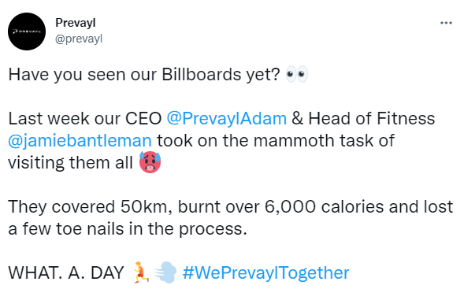
PARTNER LOGO
DOOH flexibility supports uplift in sales for Prevayl
CAMPAIGN CONTINUED..
Alight worked with Pashn Media to bring Prevayl’s media vision to life. The Prevayl team took on the challenge of running to all Alight screens in Manchester, covering over 50km and generating amazing PR activity for the brand.
The Challenge: #WePrevaylTogether
Campaign Dates
28 Feb – 20 March
Format
D48
Rate-card Investment
£31,460

Slide 4
THE RESULTS
DOOH flexibility supports uplift in sales for Prevayl
Prevayl experienced a significant increase in visits to their website from the Manchester region.
“I’d describe the campaign as being an interesting way to use DOOH, with a partner who was prepared to be way more flexible than others…
Influencers in the NW region were both much more proactive and much more interested in working with Prevayl – which was great”.
Adam Hopkinson – Founder, Pashn

