Slide 1
Alight Media & Rother Radio

Slide 2
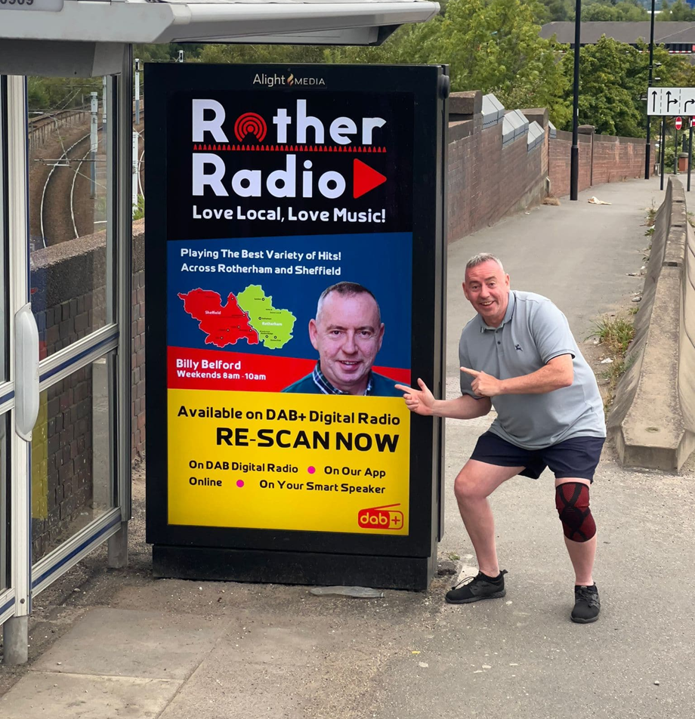
Alight delivers “massive boost” for local Radio station
The Brief
To generate awareness for Rother Radio and its availability as a new DAB channel, throughout Rotherham and Sheffield.
The Campaign
A D6 campaign, using hyper local, digital screens to generate local fame in and around the South Yorkshire towns. The campaign supported PR activity, run by the local radio station- bringing the faces of their DJs to the local community, across September 2022.
D6
449K
218k
Using availability on D6 panels across South Yorkshire
Impressions received
Plays received
Notes:
1. Lastly we have high aspirations for our connected digital future
2. We have partnered with Live Dooh Sign Kick – a specialist in DOOH
3. LD = optimisation engine which abandons the fixed 1 in 6 loop in favour of goals based delivery system.
4. Campaigns can now be planned based on Share of Time, Plays or Impressions.
5. The artificial intelligence has the ability to juggle multiple types of campaign goal on any given piece of inventory to ensure that all advertisers get exactly what they are paying for.
5. We are realy keen to connect to PS – either directly or via a platform like Hivestack in the near future - the Sign Kick engine is purpose built and ready to connect to these platforms.
6. What that means to PS is that you'll have real time access to our inventory, audiences and availability – but with the flexibility of being able to plan and buy in a number of optimized ways.

Slide 3
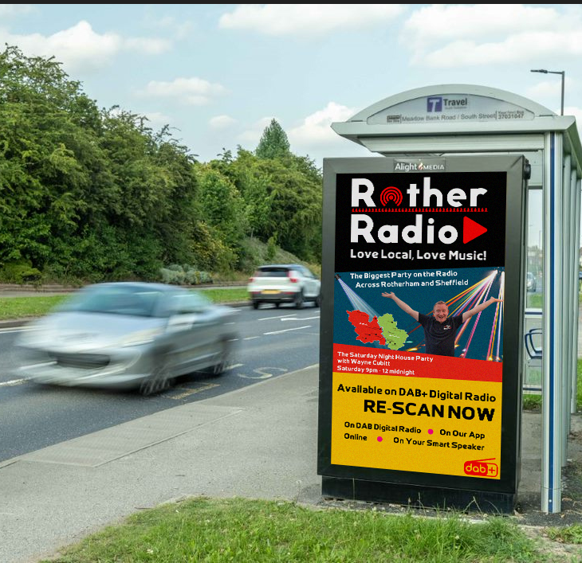
Alight delivers “massive boost” for local Radio station
The Results
The campaign played out at 191%, delivering almost 450,000 impressions over the month of September.
“The digital screen campaign was a massive boost to getting our brand out there…thank you from our team to yours”.
(Nigel James-Presenter & Sales Executive at Rother Radio)
Notes:
1. Lastly we have high aspirations for our connected digital future
2. We have partnered with Live Dooh Sign Kick – a specialist in DOOH
3. LD = optimisation engine which abandons the fixed 1 in 6 loop in favour of goals based delivery system.
4. Campaigns can now be planned based on Share of Time, Plays or Impressions.
5. The artificial intelligence has the ability to juggle multiple types of campaign goal on any given piece of inventory to ensure that all advertisers get exactly what they are paying for.
5. We are realy keen to connect to PS – either directly or via a platform like Hivestack in the near future - the Sign Kick engine is purpose built and ready to connect to these platforms.
6. What that means to PS is that you'll have real time access to our inventory, audiences and availability – but with the flexibility of being able to plan and buy in a number of optimized ways.

