Slide 1
D48 – Supermarkets
Media pack

Slide 2
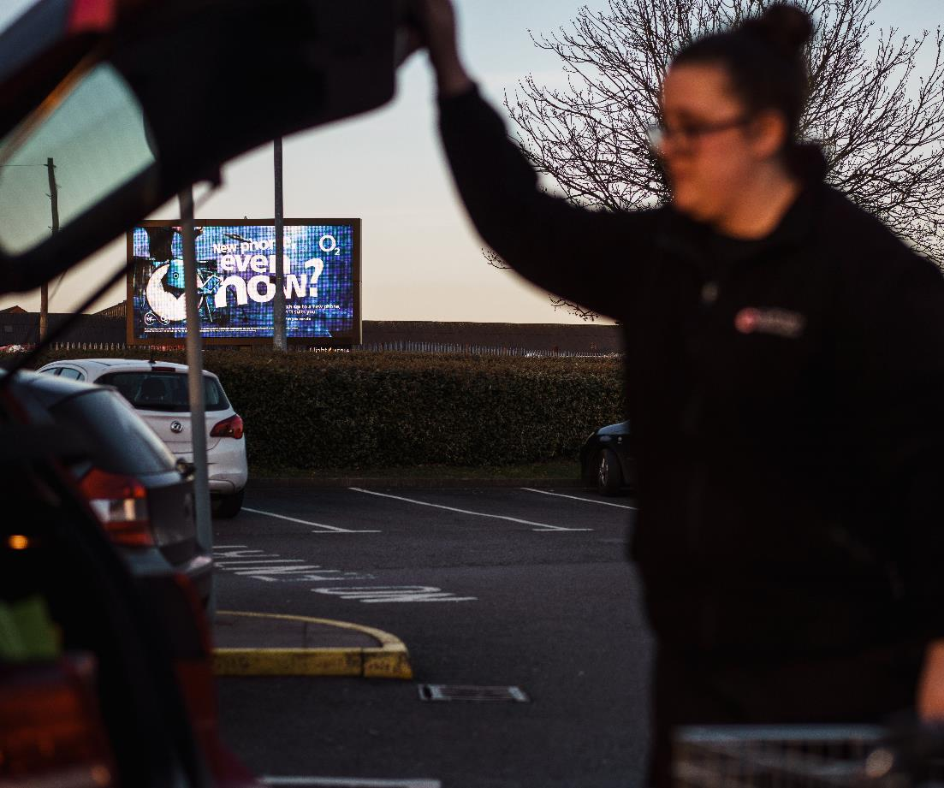
Digital 48 Sheets
Supermarket pack
140 frames within 350m of a supermarket
Make the final impressions on shoppers in the seconds before they arrive at point-of-sale
Impressions | Cover | Frequency
12M | 11.7% | 1.9
Notes:
So the three things we founded the business on are still at the core of what we believe 1) truly national cover, 2) the screen isn’t just the technology its what you do with it that matters 3) we still believe in the power of classic and have invested in the product heavily
Moving on and sharing with you what we do, we are a challenger, its difficult to imagine we will ever be the size of JCDecaux and Global but we have emerged from the long tail of the many other operators that are out there, from the scale of assets we have, size of team, market engagement In November we were the sole sponsor of the drum OOH awards), revenue potential etc we are pleased to come out of that long tail from a small business who get squeezed out quickly to a medium sized business
We want to be constructive in our challenge not just make noise for the sake of it, so that might be where we put screens, how are packages are designed, our commercial solutions, how flexible we can be when.
Critical of course in that challenge is helping your advertisers find new audiences and we develop sites in underserved areas across the UK
And we are very focused whether it be overall or plan by plan that we understand your metrics to help meet your end client needs

